Slide 1
JCM OSCE (QMH)
7 Sept 2016

Slide 2
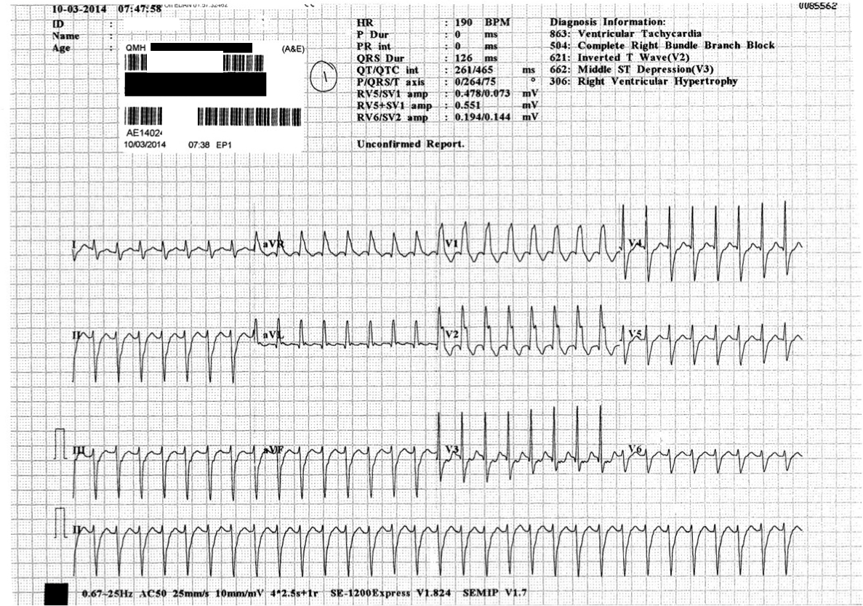
Case 1
14/M present with sudden onset SOB

Slide 3
Case 1
What are the ECG Findings:
Monomorphic ventricular tachycardia
Right bundle branch block pattern
What is the diagnosis?
Fascicular VT
Differential Diagnosis?
SVT with RBBB
Management?
Verapamil
DC Cardioversion

Slide 4
Case 2
32/M Construction site worker
Slipped and fell injury-on-duty, landed on outstretched left hand, complained of left wrist pain and swelling with decreased ROM

Slide 5
Case 2 – X Ray

Slide 6
Case 2
Describe the X Ray findings
AP:
Fractured Radial Styloid
Triangular appearance of lunate
Lateral:
Peri-lunate dislocation: Dorsal dislocation of the capitate and other carpal bones to lunate while lunate is still in contact with radial articular surface
Name the classification system of the injury
Mayfield Classification

Slide 7
Case 2
Name 3 neuro-vascular complications
Median Nerve Palsy
Compartment syndrome
Avascular necrosis
Name 1 emergency management if orthopaedic consultation is not immediately available
Closed reduction and immobilisation
Describe 2 approaches to definitive management
Second stage ligament repair and internal fixation
Emergent open reduction and internal fixation (if failed closed reduction)

Slide 8
Case 2
Mayfield Classification
Stage I | scapholunate dissociation
Stage II | + lunocapitate disruption
Stage III | + lunotriquetral disruption, "perilunate”
Stage IV | lunate dislocated from lunate fossa (usually volar) “lunate” associated with median nerve compression

Slide 9
Case 3
39/M presented with generalized tonic-clonic seizure for 1 hour
He appeared to be confused for several hours prior to the seizure
He has no fever, no TOCC, no recent head injury

Slide 10
Case 3 – plain CT Brain

Slide 11
Case 3
Name the CT findings
Left hyperdense MCA sign
Diagnosis
Ischaemic Stroke, left MCA territory infarct
Name 4 early radiological signs for this condition
Loss of insular ribbon sign
Hypoattenuation of basal ganglia
Obscuration of sylvian fissure
Effacement of cortical sulci

Slide 12
Case 3
Name 3 imaging options that may aid in management
MRI/MRA
CT angiogram
Digital Subtraction Angiogram
Carotid doppler USG
Echocardiogram

Slide 13
Case 4
34/M
presented with sudden onset non-exertional chest pain and right neck pain

Slide 14
Case 4
Name 1 pathological X-Ray finding
Right supraclavicular subcutaneous emphysema
Name 3 possible causes of the above condition
Pneumothorax
Pneumomediastinum
Pneumopericardium
Iatrogenic
Trauma/barotrauma
Broncho-subcutaneous fistula
Name 1 physical sign of the above condition
Crepitus on palpation

Slide 15
Case 4
Name 3 other X-Ray views should be taken
Lateral CXR
Decubitus CXR
Cervical spine/Neck X Ray
Name 1 other imaging that may be useful
CT Scan of thorax

Slide 16
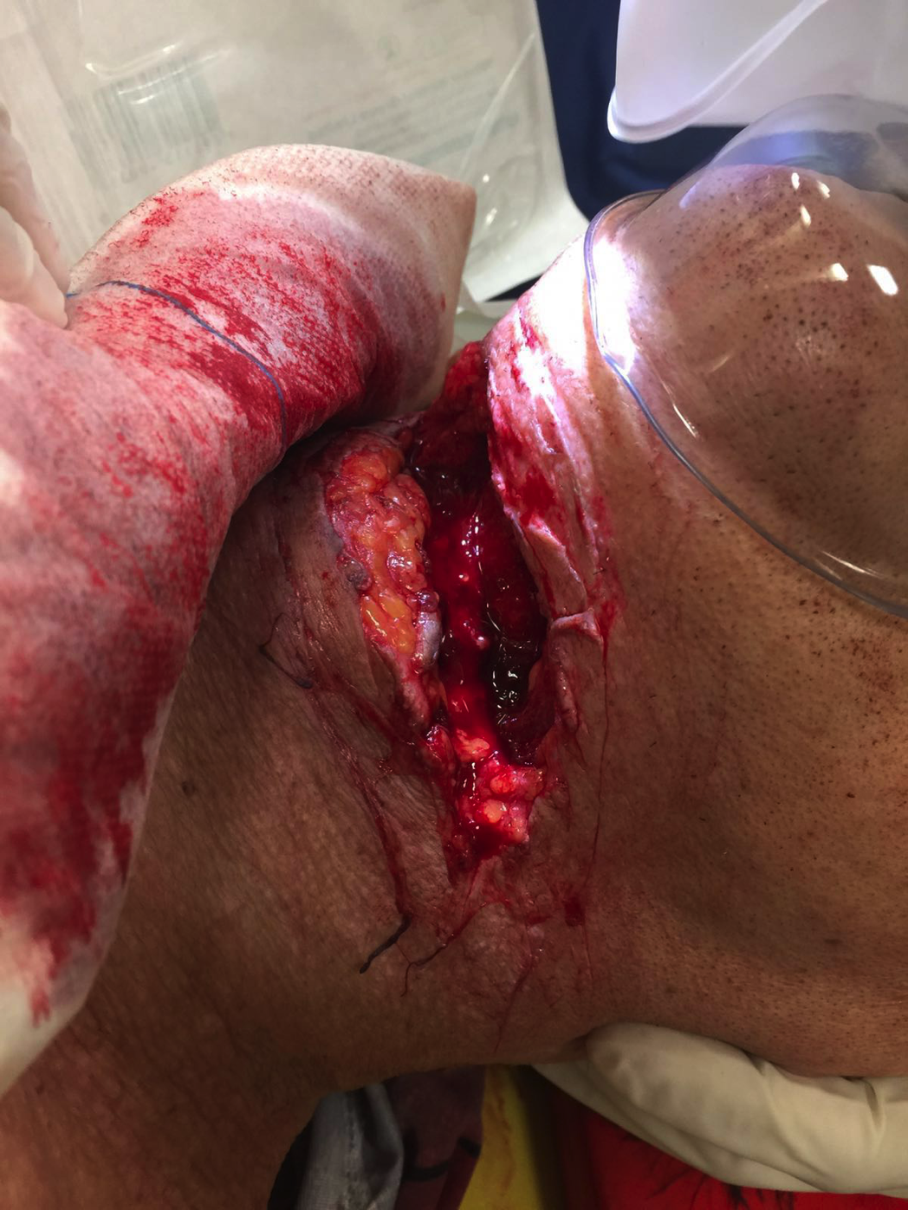
Case 5
75/M
Suicidal attempt, cut his throat with a knife multiple times
Stable, GCS full SpO2 100%
Chest clear, AE equal
Neurological exam unremarkable

Slide 17
Case 5
How is the neck divided into zones?
Zone I: between the clavicle/suprasternal notch and the cricoid cartilage encompassing the thoracic outlet structures.
Zone II: between the cricoid cartilage and the angle of the mandible.
Zone III: between the angle of the mandible and the base of the skull.

Slide 18
Case 5
Which zone is injured in the patient
Zone 2
What structures were possibly injured
Internal and external carotid arteries
Internal and external jugular veins
Airway (Larynx, trachea)
Thyroid and parathyroid
Neck muscles

Slide 19
Case 5
What immediate measures should be taken in A&E
Airway control, may require prophylactic intubation or cricothyroidotomy or tracheostomy
Large bore IV cannula, resuscitation with IV fluid and blood transfusion
(Surgical exploration is not appropriate in A&E)
What other investigations may be useful?
CXR, lateral neck X-Ray
Angiogram
OGD
Laryngoscopy
CT Scan

Slide 20
Case 5
What complications may need to be looked out for?
Thromboembolic stroke
Ischaemic stroke secondary to hypoperfusion
Airway/laryngeal oedema
Pneumothorax/pneumomediastinum
Large hematoma
Recurrent laryngeal nerve injury

